Slide 1
Multi-Task Learning

Slide 2
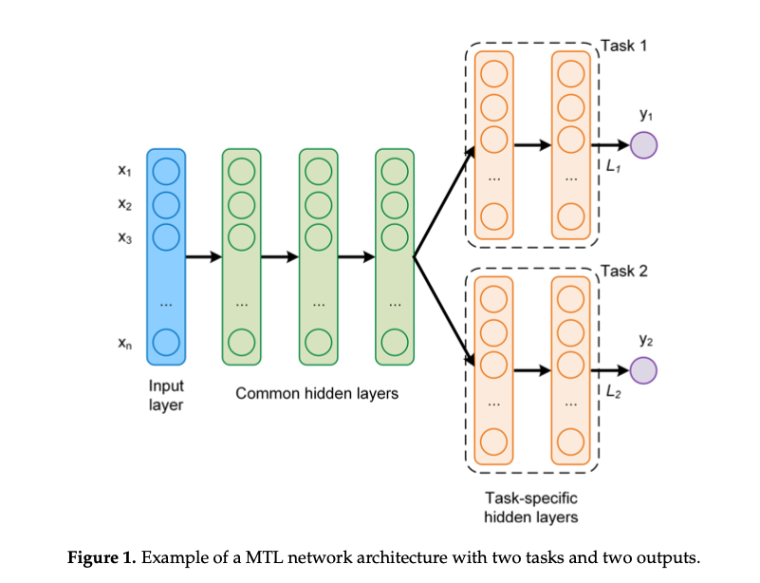
Venturini, Francesca, Umberto Michelucci, and Michael Baumgartner. "Dual oxygen and temperature luminescence learning sensor with parallel inference." Sensors 20.17 (2020): 4886.

Slide 3
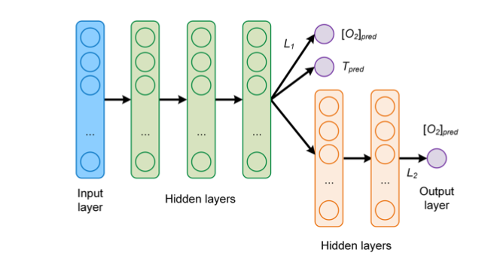
Venturini, Francesca, Umberto Michelucci, and Michael Baumgartner. "Dual oxygen and temperature luminescence learning sensor with parallel inference." Sensors 20.17 (2020): 4886.

Slide 4
input_x = keras.layers.Input(shape = (16,))
lay1 = layers.Dense(64, activation='sigmoid', dtype = tf.float32)(input_x)
lay2 = layers.Dense(32, activation='sigmoid')(lay1)
lay3 = layers.Dense(32, activation='sigmoid')(lay2)
outboth = layers.Dense(2, activation='sigmoid',name="both_output")(lay3)
lay4 = layers.Dense(3, activation='sigmoid')(lay3)
outo2 = layers.Dense(1, activation = 'sigmoid',name="O2_output")(lay4)
model = Model( inputs=input_x, outputs=[outboth, outo2])
Venturini, Francesca, Umberto Michelucci, and Michael Baumgartner. "Dual oxygen and temperature luminescence learning sensor with parallel inference." Sensors 20.17 (2020): 4886.

Slide 5
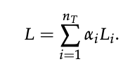
Loss Functions
losses = { "both_output": "mae", "O2_output": "mae", }
lossWeights = {"both_output": 0.3, "O2_output": 1.0}
opt = Adam(lr=1e-3)
model.compile(optimizer=opt, loss=losses, loss_weights=lossWeights, metrics=["mae"])

Slide 6
Training
H = model.fit(data_train, {"both_output": targets_train, "O2_output": targets_train_O2},
validation_data=(data_dev, {"both_output": targets_dev, "O2_output": targest_dev_O2}),
epochs=1000, verbose=0, callbacks = [CustomCallback_()])

Slide 7
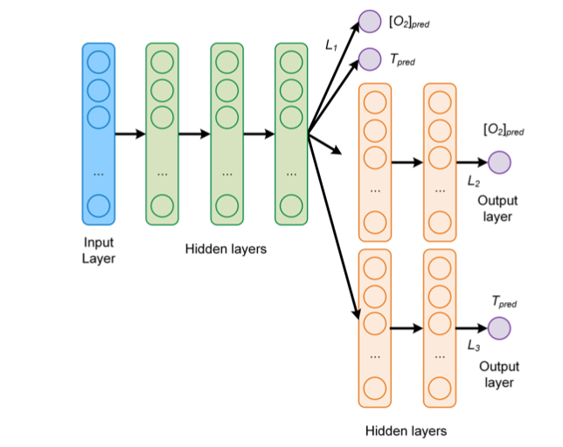
Venturini, Francesca, Umberto Michelucci, and Michael Baumgartner. "Dual oxygen and temperature luminescence learning sensor with parallel inference." Sensors 20.17 (2020): 4886.

